Slide 1


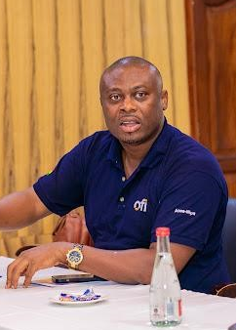
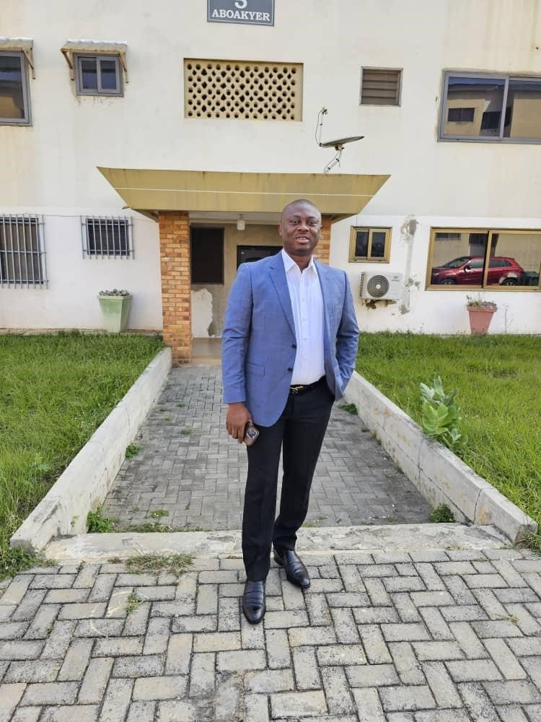
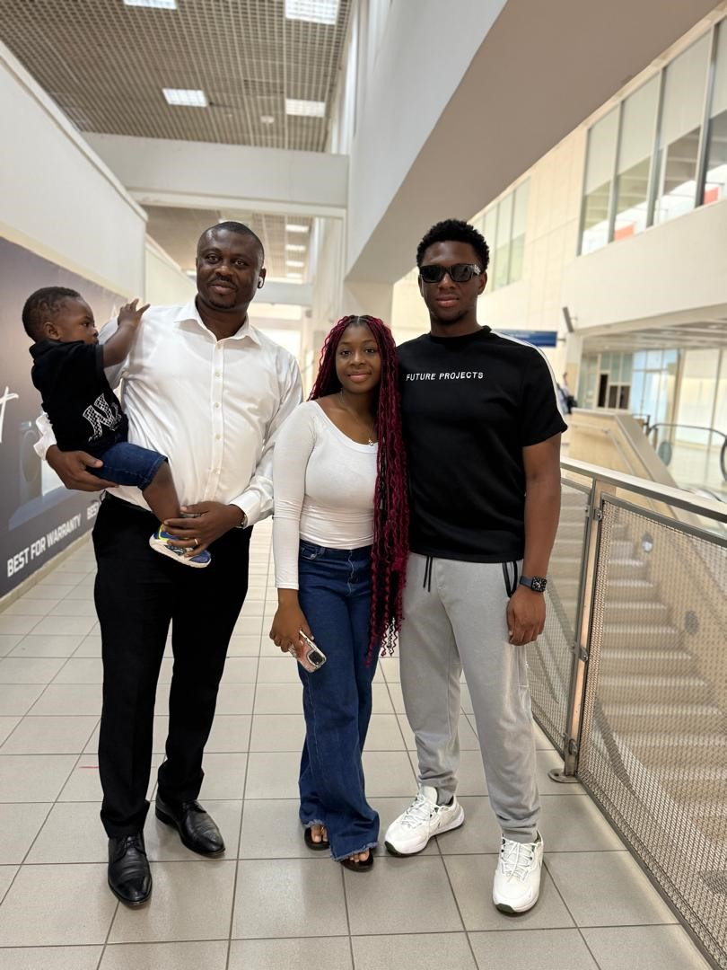
Getting to Know Me
Work
Personal
My role
General Manager, Cashew
Significant others / family members / furry friends in my life
Patience, Joshuan, Illiasu
Tenure in ofi/Olam
18 years
How I enjoy spending my free time
With family and friends
Previous companies I have worked at
Olam
My favorite / comfort food
Fufu and light soup
Why I joined ofi/Olam and what keeps me here?
See growth and future in Olam/Ofi
My favorite song
Fugees – How many mics
Rapheal Yussif Amankwa
Yussif
A few fun facts about me
Olam cashew keeper
This is me outside work, doing stuff I enjoy in my life …

